Slide 1




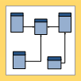
Technologies Used…
Power BI Desktop

